Slide 1
Assignment 2 – Redesign a Notable Information Graphic
Snow's cholera map
Chengyang Ge
100983921
Ontario Tech University
Visualization & Storytelling
Gabby Resch
October 19, 2025

Slide 2
Preparation

Slide 3
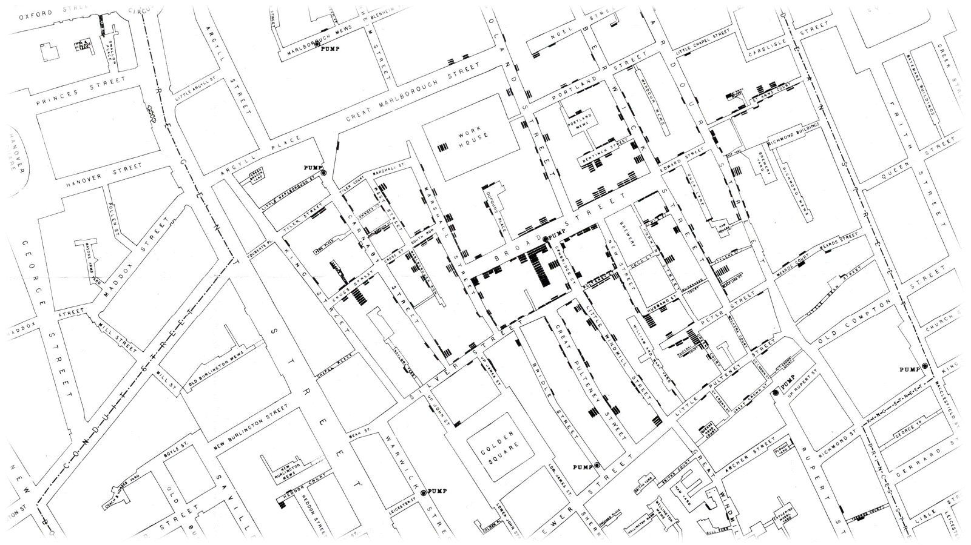
John Snow’s cholera map was produced in 1854.

Slide 4
Compared with analytic maps created using modern GIS software, it has several limitations:
The short ticks used to represent deaths overlap at addresses with high mortality, making it difficult for observers to accurately count or interpret the number of deaths at a given location
The contemporary basemap is not especially intuitive for modern audiences
The hand-drawn format cannot accommodate additional data layers for deeper exploration.

Slide 5
Therefore, I attempted to reconstruct this cholera map in QGIS

Slide 6
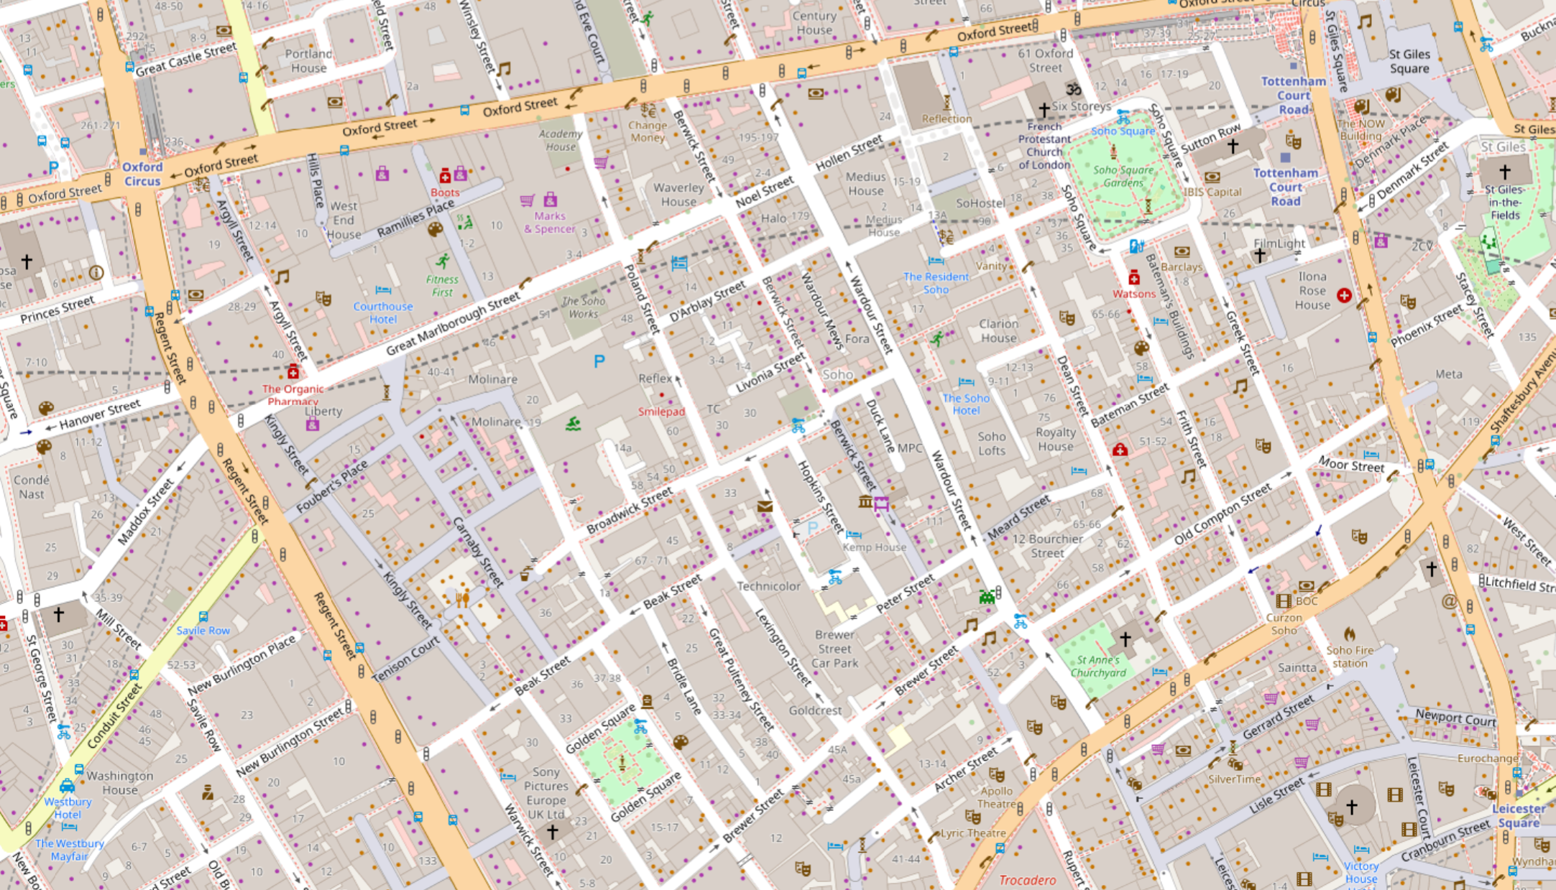
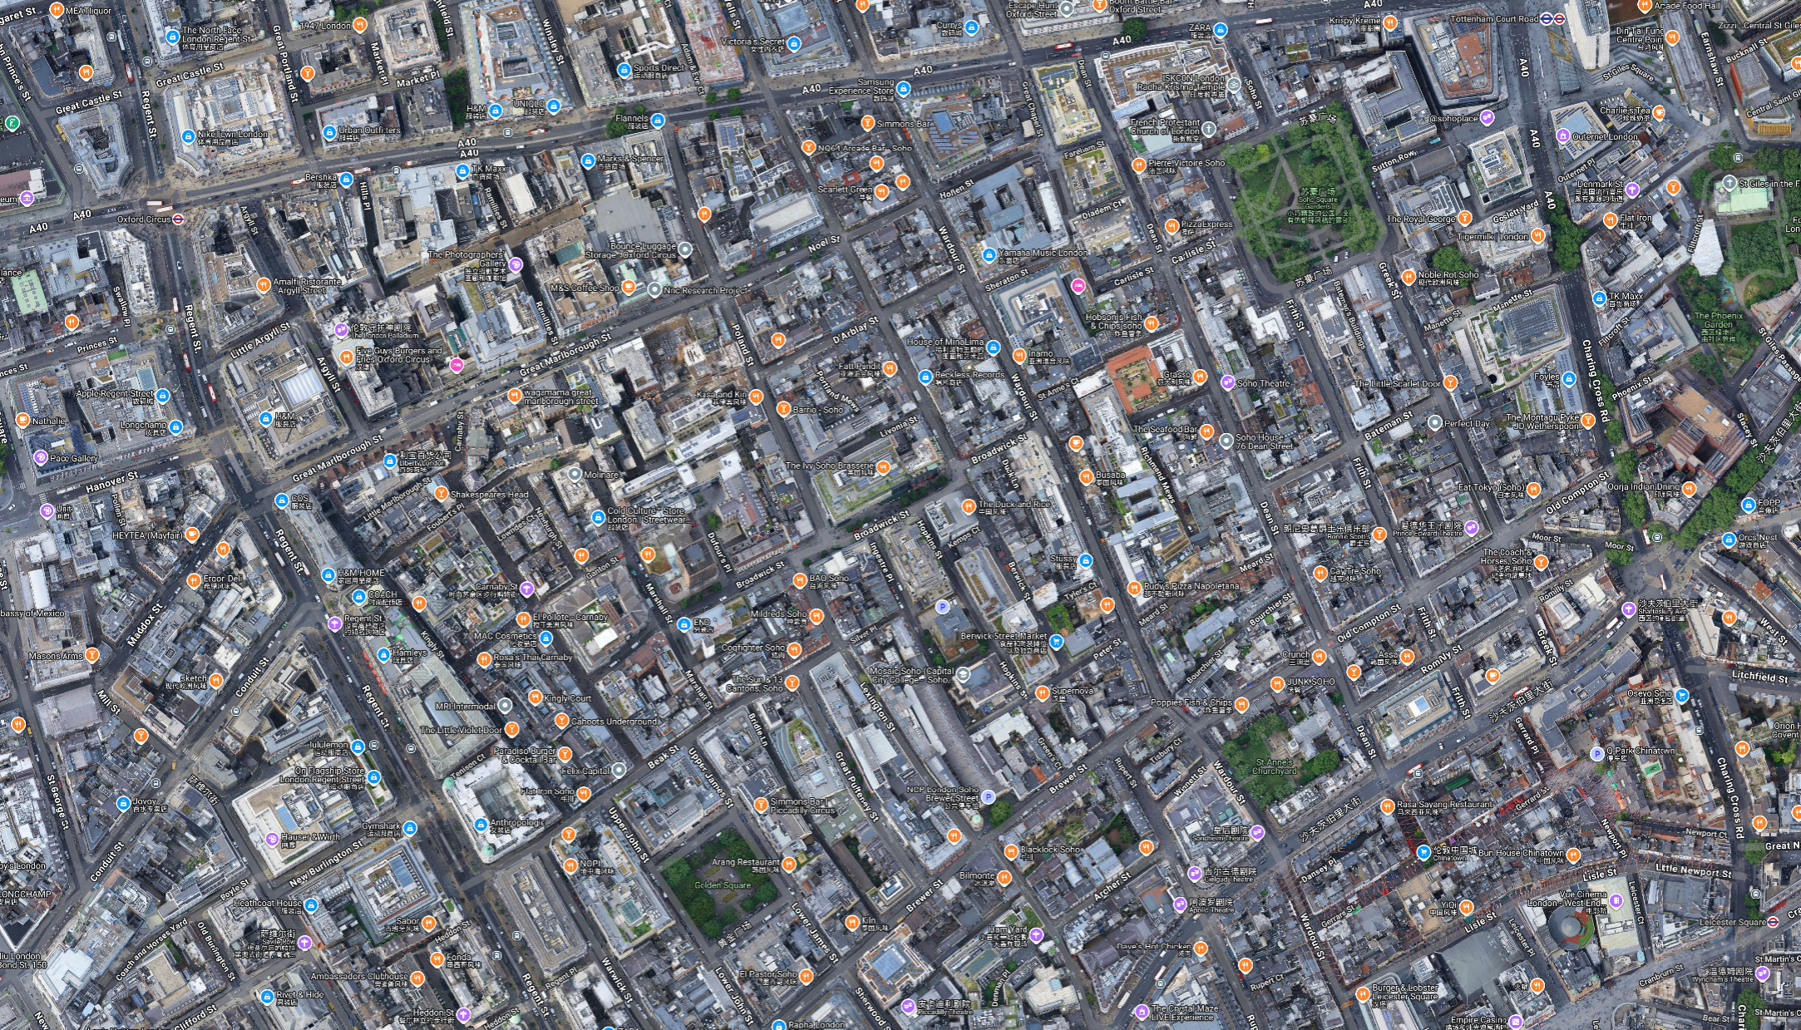
First, for the basemap, I chose a standard vector map rather than satellite imagery. The cleaner, more minimalist vector style makes the map’s purpose easier to convey.

Slide 7
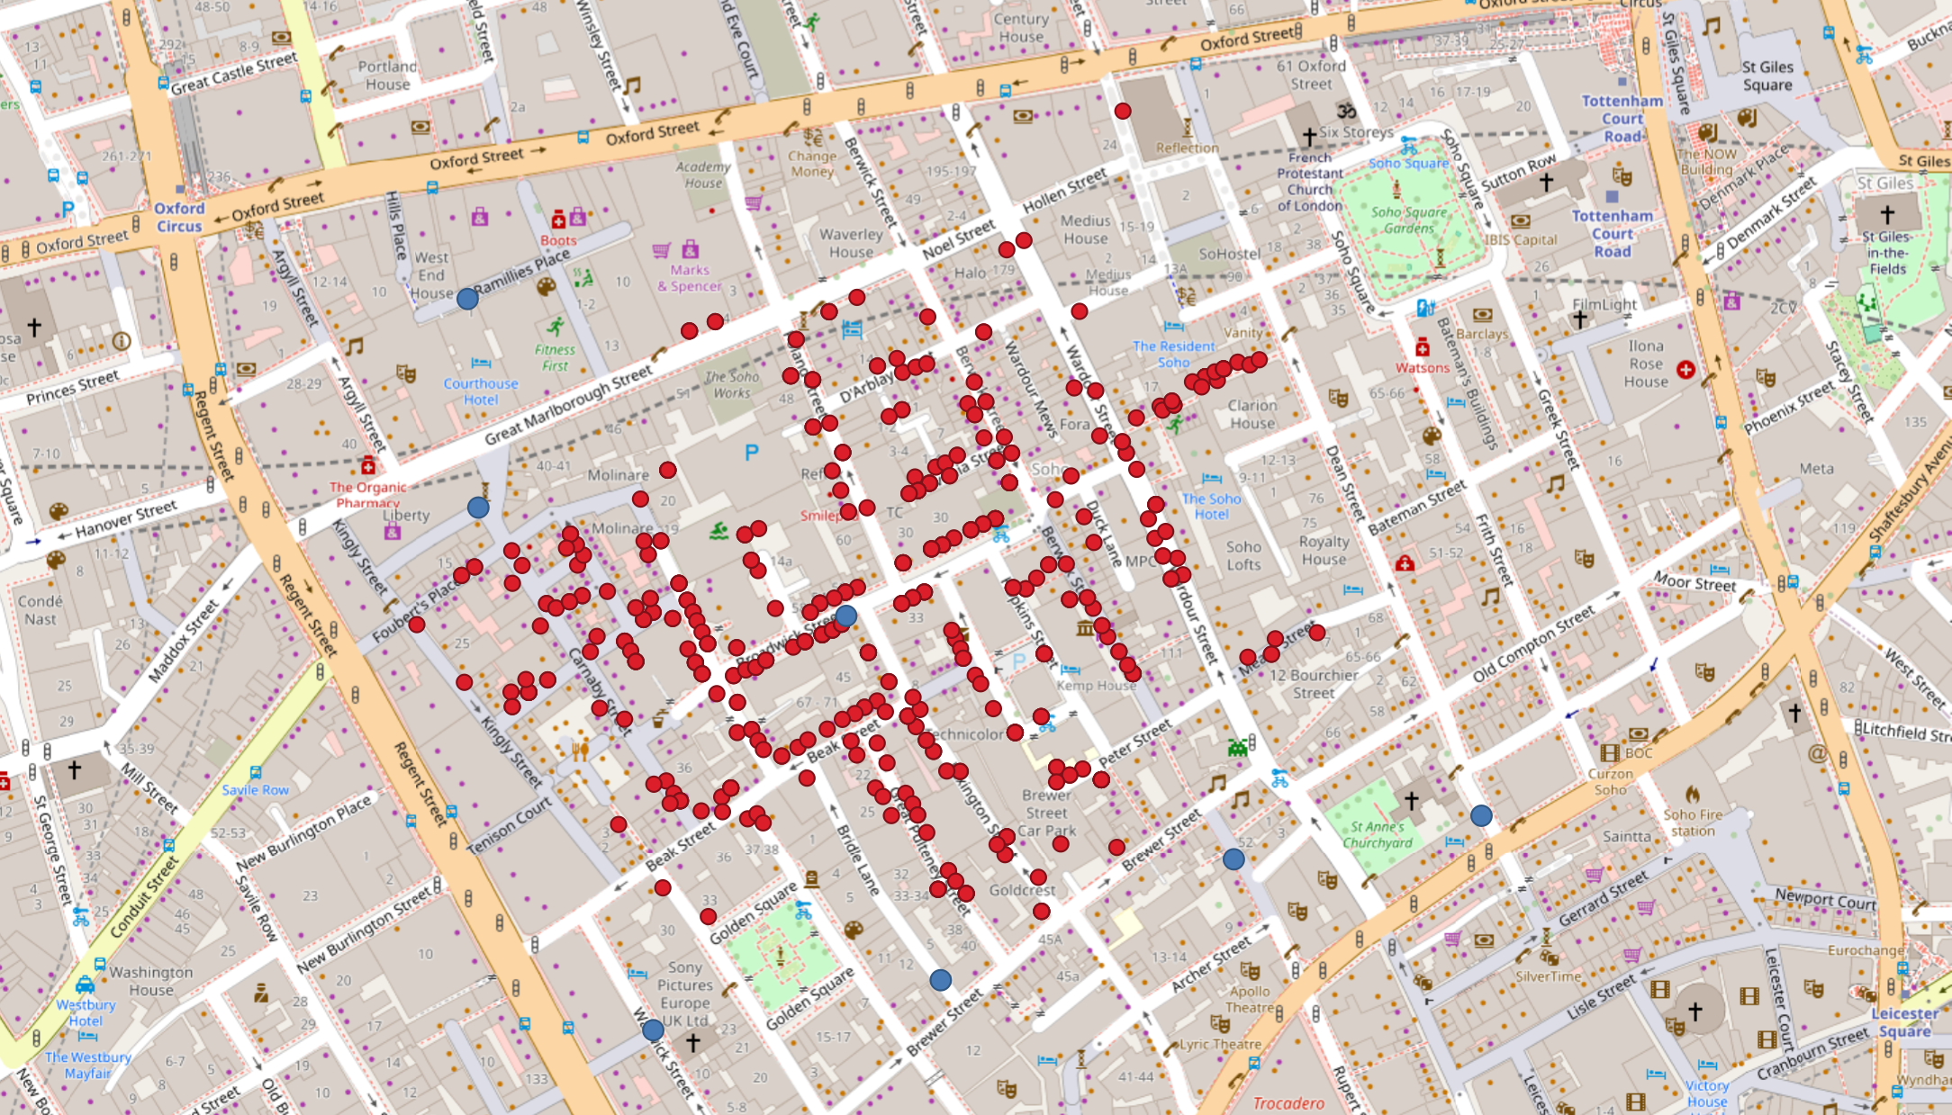
Next, I imported the geocoded death records and pump locations, styling death sites as red points and pumps as blue points.

Slide 8
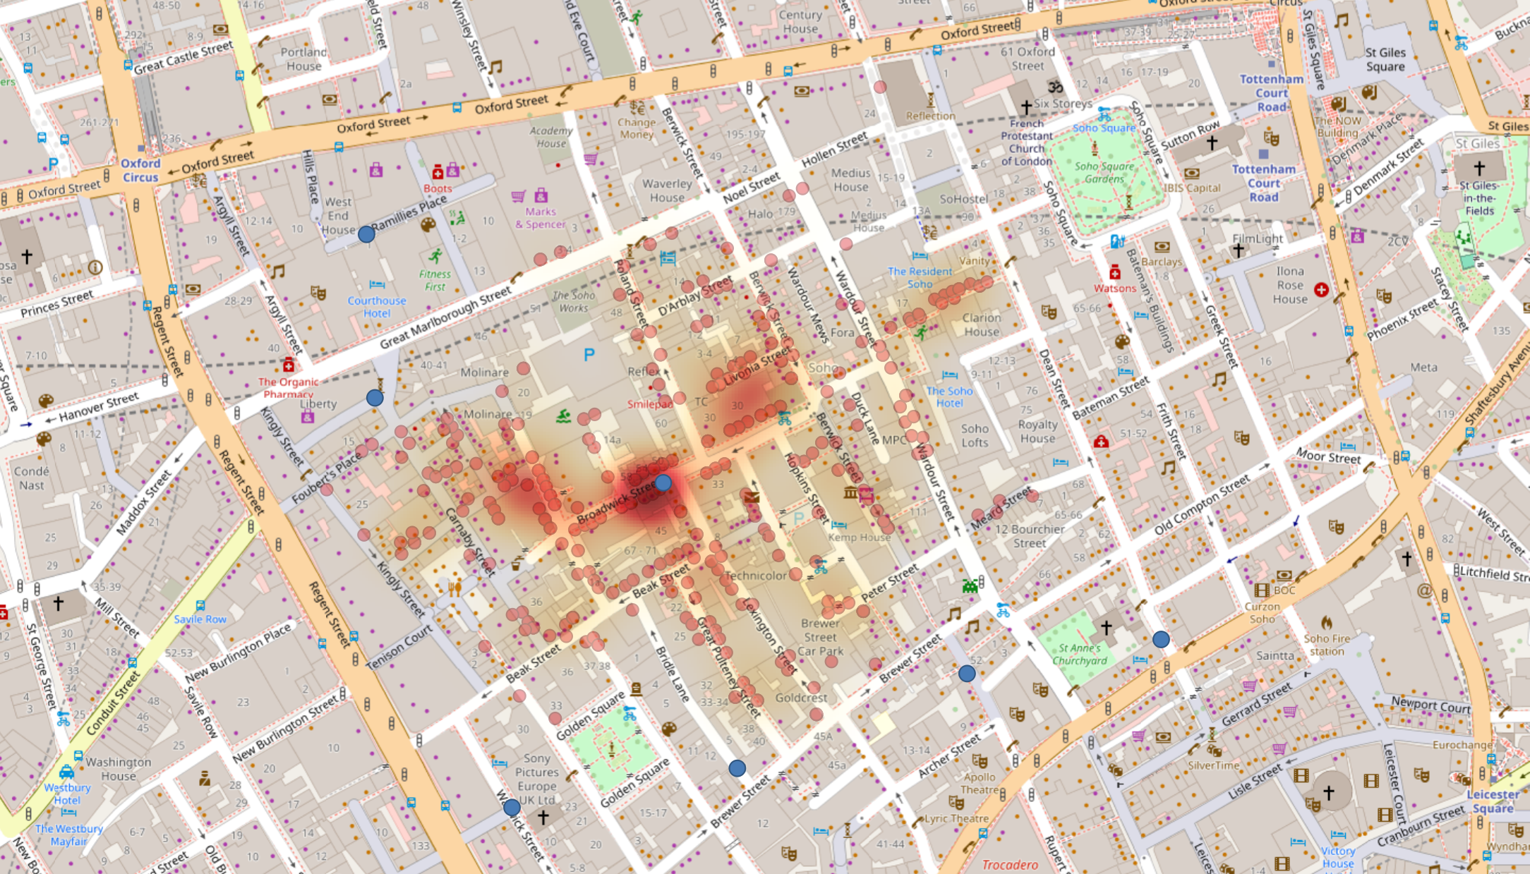
Through the heatmap analysis, we quickly arrived at Snow’s key finding from the cholera map: most deaths were concentrated around the Broadwick Street pump.

Slide 9
Historical accounts note that certain places—such as the nearby brewery and the workhouse—were largely spared, likely because workers drank beer or drew water from their own well rather than the contaminated public pump.
These contextual factors cannot be fully captured on the map and would require on-the-ground/archival investigation to document precisely.
Even so, the map—just as it did then—shows a clear spatial signal: outside the vicinity of the Broadwick Street pump, deaths drop sharply around the other pumps. That pattern helps prioritize fieldwork—examining why those pumps saw fewer cases and how access routes and habits shaped exposure.

Slide 10
Using the heatmap analysis above, we could quickly reproduce Snow’s central insight: most cholera deaths clustered around the Broad Street pump. But compared with 1854, today there is much more we can explore.
I use OpenStreetMap with Overpass Turbo to download modern address/building points for the Broad Street (Soho) study area. Because these features include geographic coordinates, we can load them into QGIS, clip them to the cholera map extent, and aggregate them to construct a proxy for local population intensity. We then compare this proxy surface with the cholera deaths heatmap and pump locations to visualize how “where people are” (today) aligns or diverges from the historical outbreak pattern.
Crucially, OpenStreetMap captures current urban form, not London in 1854. The density we derive from OSM addresses/buildings is not historical population density; it is a contemporary proxy used purely for illustration of the workflow. Any apparent alignment or mismatch between the modern proxy and the historical cholera clusters should not be interpreted as evidence about the 1854 epidemic—it simply demonstrates how such analyses would proceed if true historical population data were available.

Slide 11
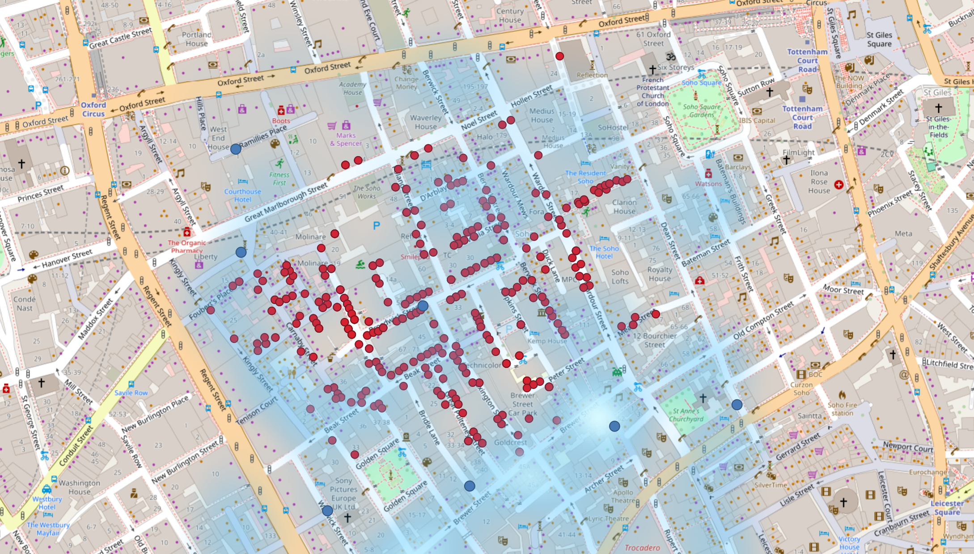
Overlaying deaths with a population-density surface demonstrates a positive correlation between death intensity and where people live/work. While the density layer is contemporary, it still offers a useful proxy, suggesting this part of Soho has persisted as a densely populated district from the 19th century to today.

Slide 12
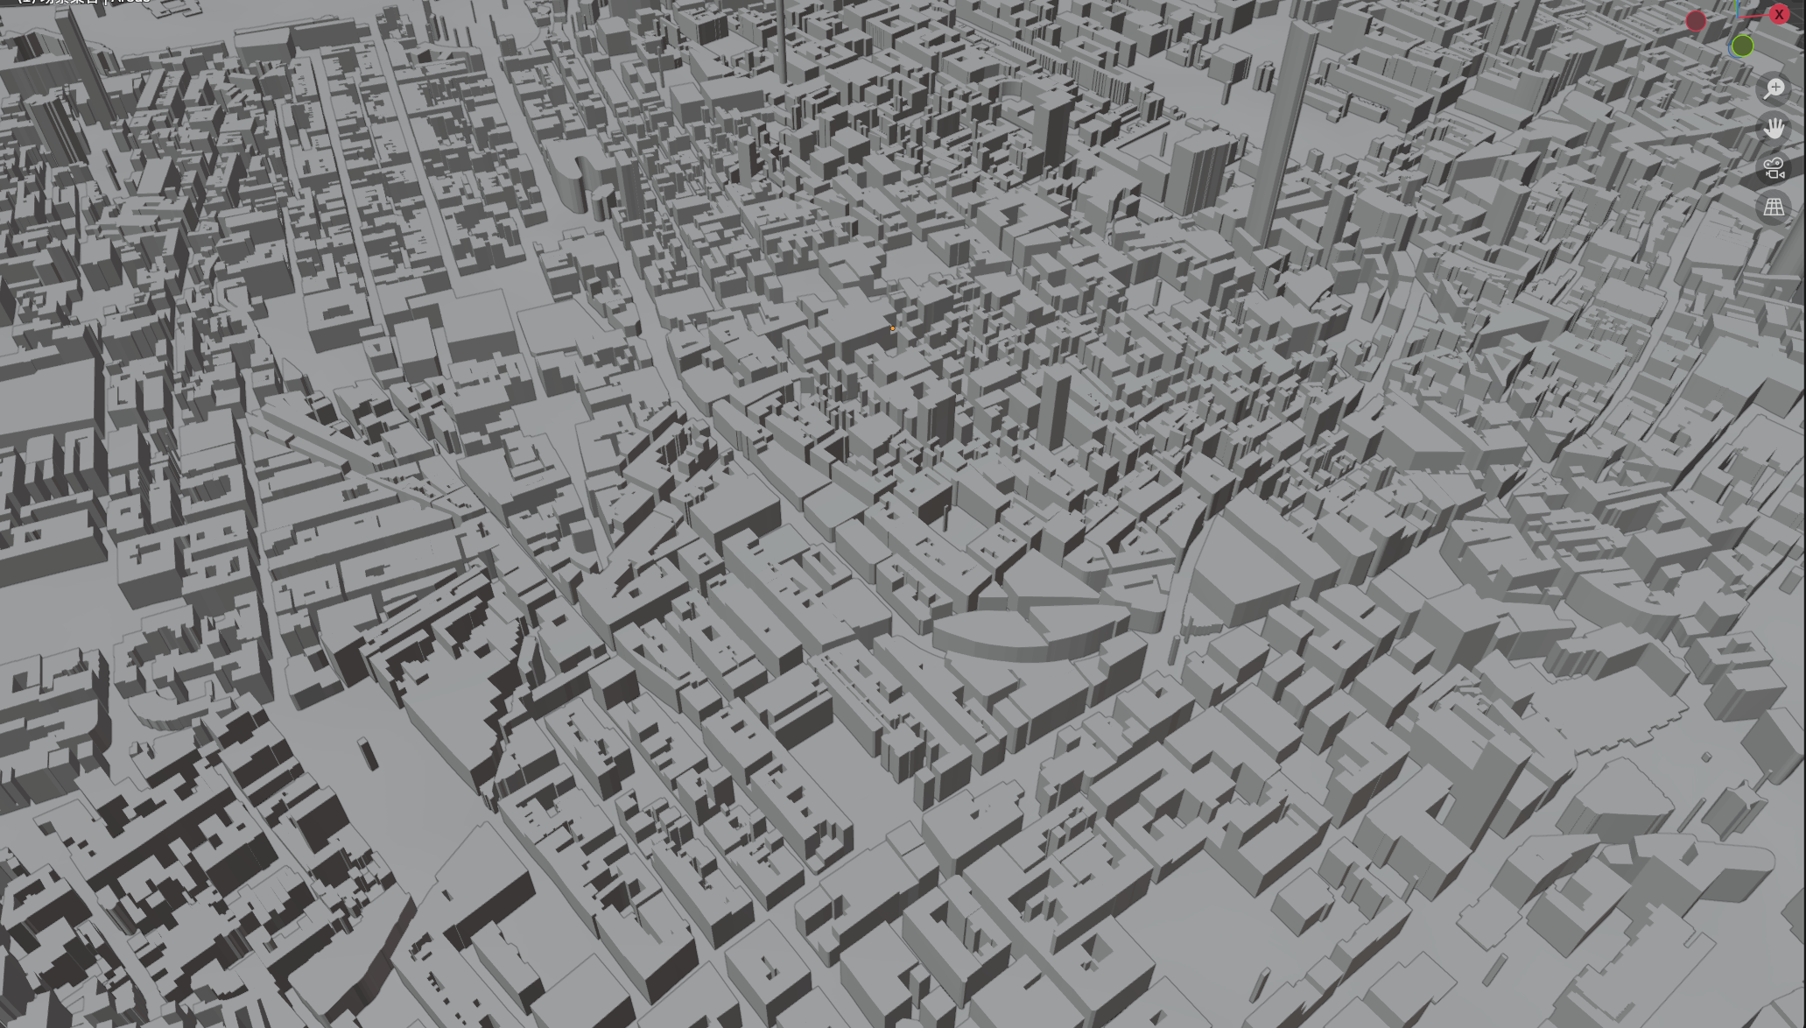
After confirming the Broadwick Street cluster on 2D overlays and heatmaps, I still felt distance and exposure were abstract. I pulled the Soho basemap and building footprints directly in Blender using BlenderGIS, extruded footprints to simple massing, and organized ground vs. buildings as clean collections.

Slide 13
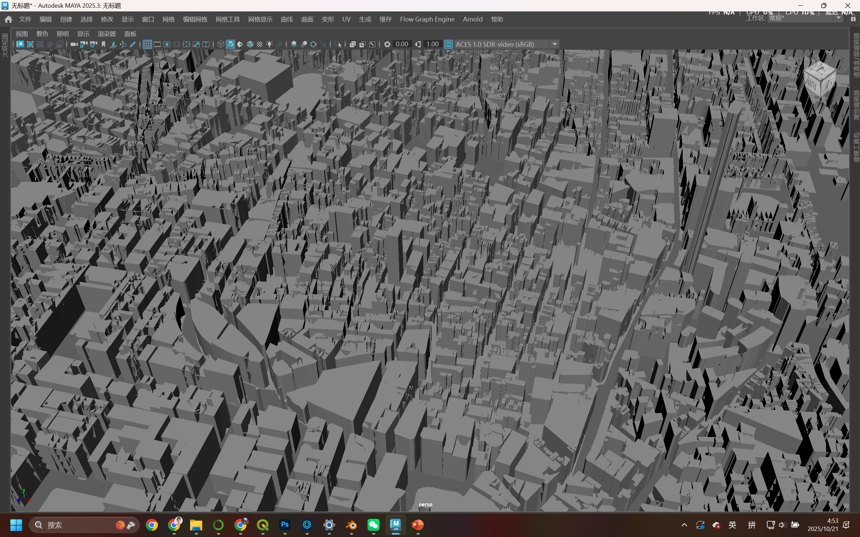
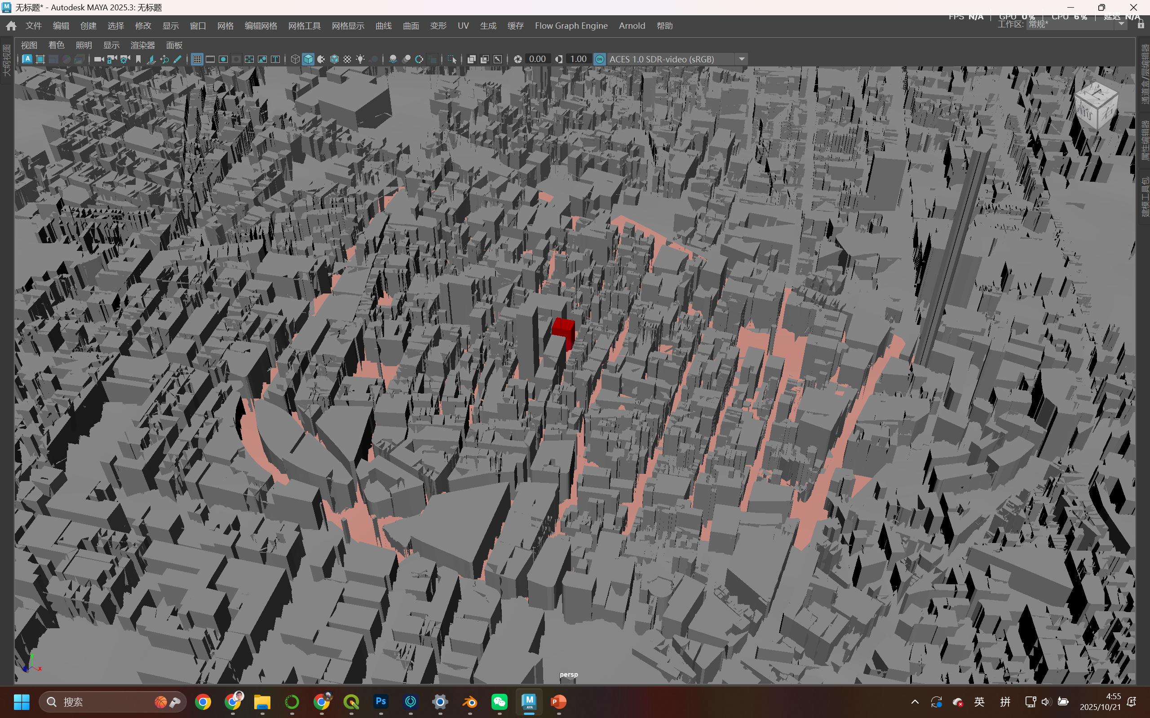
Next, save the model as FBX, then export to Maya for look-development. My goal now is to simulate the outbreak dynamically—linking time stamps, case counts, and expanding impact zones to camera moves and environmental cues, so viewers sense how the epidemic unfolds in space.

Slide 14
Next, save the model as FBX, then export to Maya for look-development. My goal now is to simulate the outbreak dynamically—linking time stamps, case counts, and expanding impact zones to camera moves and environmental cues, so viewers sense how the epidemic unfolds in space.

Slide 15
The final deliverable is an interactive interface with a draggable timeline at the bottom. As the timeline advances, the scene reveals cholera dynamics: red case dots appear/disappear by date with a daily vs. cumulative toggle; a density heatmap deepens cumulatively (and can switch to daily density to show spread direction); each new case emits a soft infection/ incubation halo for 2–5 days that fades; key event markers (e.g., first surge, Broad Street pump handle removal) pop up at the corresponding dates; and bars on buildings encode daily or cumulative counts per building. Filters in the top-right let me toggle layers and modes (points, heatmap, halos, bars) and focus specific streets or periods.

